Slide 1
Pedestrian Detection and Localization
Members:
Đặng Trương Khánh Linh 0612743
Bùi Huỳnh Lam Bửu 0612733
Advisor:
A.Professor Lê Hoài Bắc
UNIVERSITY OF SCIENCE
ADVANCED PROGRAM IN COMPUTER SCIENCE
Year 2011

Slide 2
Problem statement
Build up a system which automatically detects and localizes pedestrians in static image.
Constraints:
Pedestrians stand up and fully visible people.
Size of pedestrian is not less than 64x128 pixels.

Slide 3
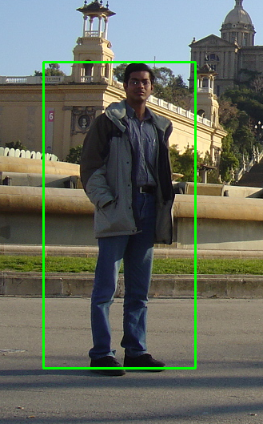
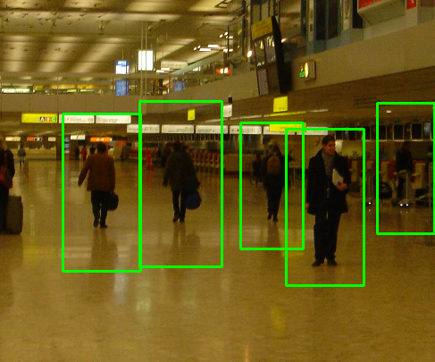
Some examples

Slide 4
Applications
Using in smart car system, or smart camera in general.
Build a software to categorize personal album images to proper catalogue.

Slide 5
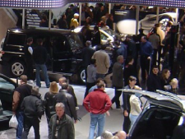
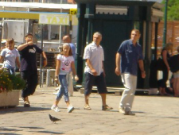
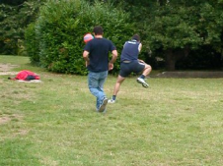
Challenges
Huge variation in intra-class.
Variable appearance and clothing.
Complex background.
Non-constraints illumination.
Occlusions, different scales.

Slide 6
Outline
Existing approaches.
Motivation.
Overview of methodology.
Learning phase
Detection
Some contributions:
Spatial selective approach
Multi-level based approach
Non-maxima Suppression
Conclusions
Future work
Reference

Slide 7
Existing approaches
Haar wavelets + SVM: Papageorgiou & Poggio, 2000; Mohan et al 2000
Rectangular differential features + adaBoost: Viola & Jones, 2001
Model based methods: Felzenszwalb & Huttenlocher, 2000; Loffe & Forsyth, 1999
Lowe, 1999 (SIFT).
LBP, HOG, …

Slide 8
Motivation of choosing HOG
The blob structure based methods are false to object detection problem.
Use the advantage of rigid shape of object.
Low complexity and fast running time.
Has a good performance.

Slide 9
Contributions
Re-implement HOG description.
Spatial Selective Method.
Multi-level Method.

Slide 10
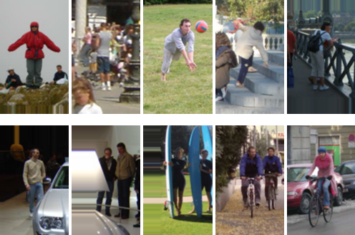
Dataset
INRIA pedestrian dataset
Train: 1208 positive windows 1218 negative images
Test: 566 positive windows 453 negative images

Slide 11
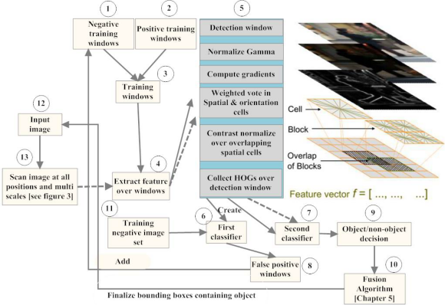
Overview of methodology

Slide 12
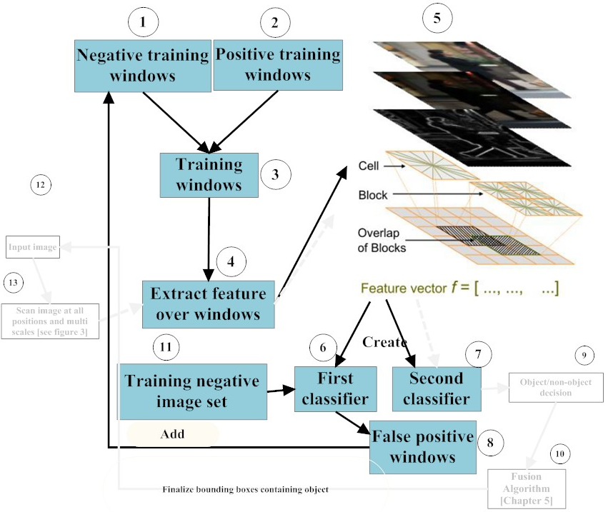
Learning Phase

Slide 13
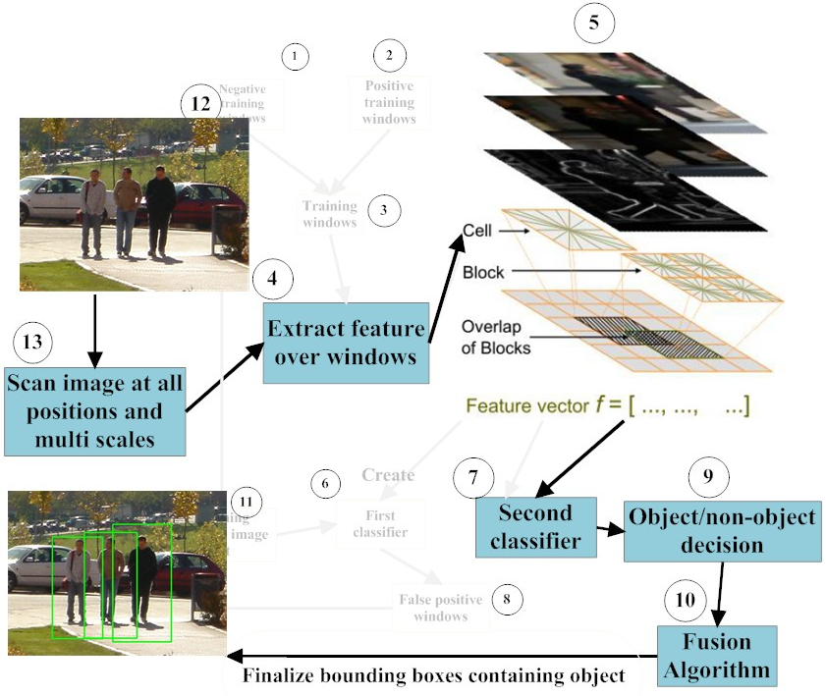
Detection Phase

Slide 14
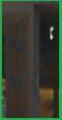
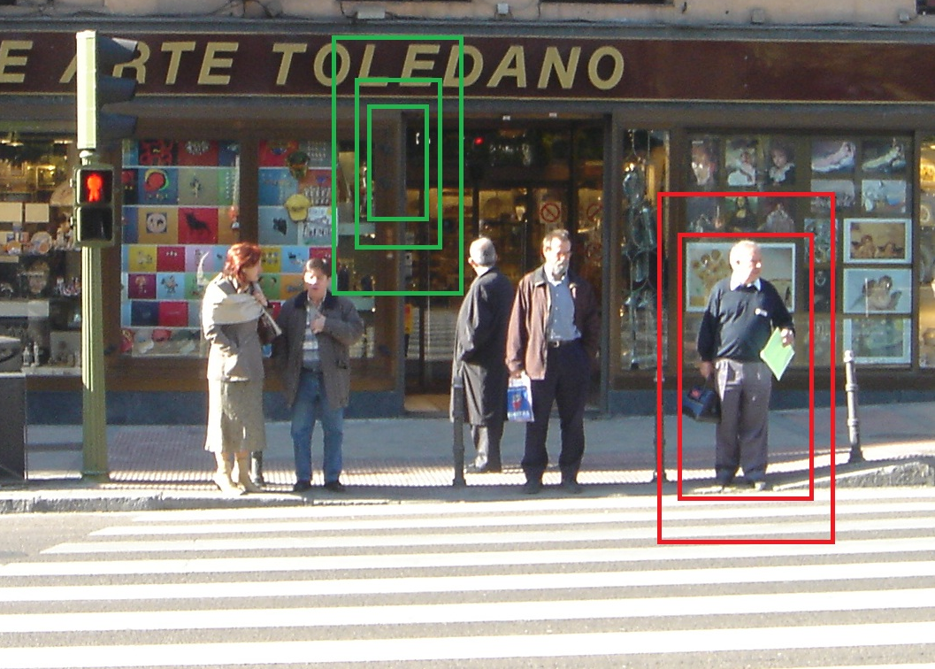
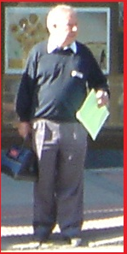
Scan image at all positions and scales
Object/Non-object classifier

Slide 15
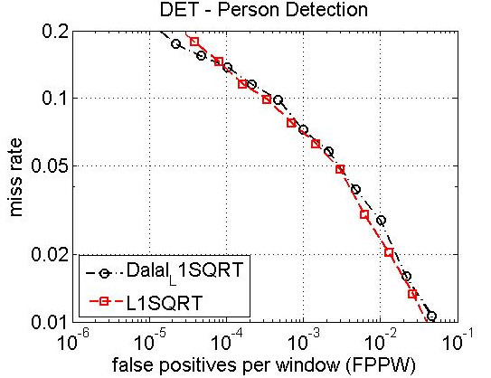
Result of experiment

Slide 16
Some Contributions
IMPROVEMENTS
SPEED UP
(Spatial Selective Approach)
PERFORMANCE
(Multi-Level Approach)

Slide 17

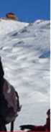
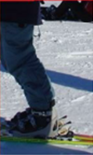
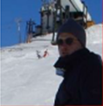
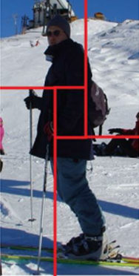
Spatial Selective Approach
Less informative region
HOG
[A1,..,Z1]
[A2,..,Z2]
[A3,..,Z3]
[A4,..,Z4]
[A1,..,Z1, A2,..,Z2, A3,..,Z3, A4,..,Z4]

Slide 18
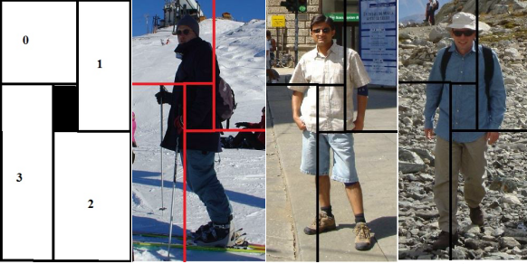
Spatial Selective Approach
Examples:

Slide 19
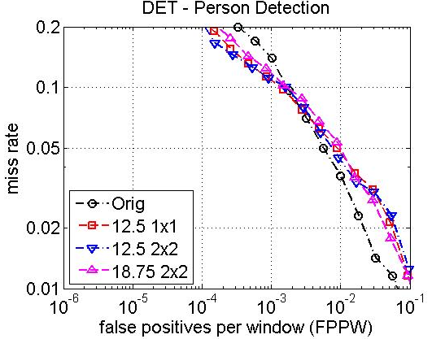
Result

Slide 20
Vector Length v.s Speed
A:B → Deleted cell(s): Overlap cell(s)

Slide 21
Multi-level Approach
Purpose: enhance the performance by getting more information about shape and contour of object.

Slide 22

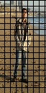
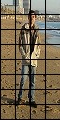
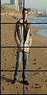
Multi-level Approach
HOG
[A1,..,Z1]
[A2,..,Z2]
[A3,..,Z3]
[A1,..,Z1, A2,..,Z2, A3,..,Z3, A4,..,Z4]

Slide 23
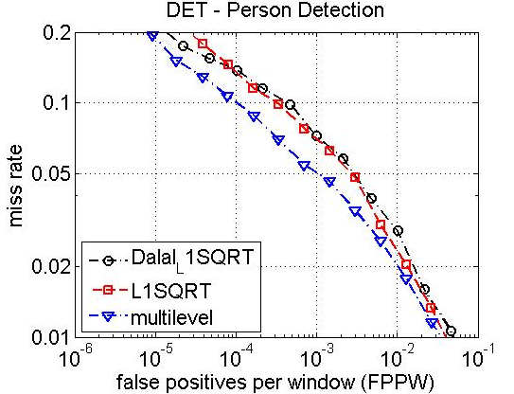
Result

Slide 24
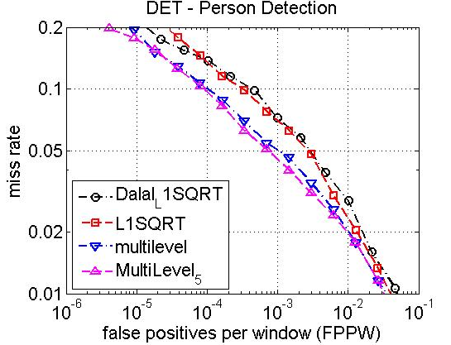
Result(cont…)

Slide 25
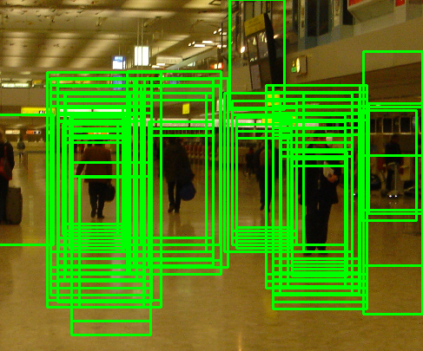
Mean Shift as Non-maxima Suppression

Slide 26
Mean shift
Region of
interest
Center of
mass
Mean Shift
vector
Slide by Y. Ukrainitz & B. Sarel

Slide 27
Mean shift
Region of
interest
Center of
mass
Mean Shift
vector
Slide by Y. Ukrainitz & B. Sarel

Slide 28
Mean shift
Region of
interest
Center of
mass
Mean Shift
vector
Slide by Y. Ukrainitz & B. Sarel

Slide 29
Mean shift
Region of
interest
Center of
mass
Mean Shift
vector
Slide by Y. Ukrainitz & B. Sarel

Slide 30
Mean shift
Region of
interest
Center of
mass
Mean Shift
vector
Slide by Y. Ukrainitz & B. Sarel

Slide 31
Mean shift
Region of
interest
Center of
mass
Mean Shift
vector
Slide by Y. Ukrainitz & B. Sarel

Slide 32
Mean shift
Region of
interest
Center of
mass
Slide by Y. Ukrainitz & B. Sarel

Slide 33
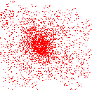
Mean shift clustering
Cluster: all data points in the attraction basin of a mode
Attraction basin: the region for which all trajectories lead to the same mode
Slide by Y. Ukrainitz & B. Sarel

Slide 34
Non-maximum suppression
Using non-maximum suppression such as mean shift to find the modes.

Slide 35
Conclusions
Successfully re-implement HOG descriptor.
Propose the Spatial Selective Approach which take advantages of less informative center region of image window.
Multi-level has more information about shape and contour of object.

Slide 36
Future work
Non-uniform grid of points.
Combination of Spatial Selective and Multi-level approach.

Slide 37
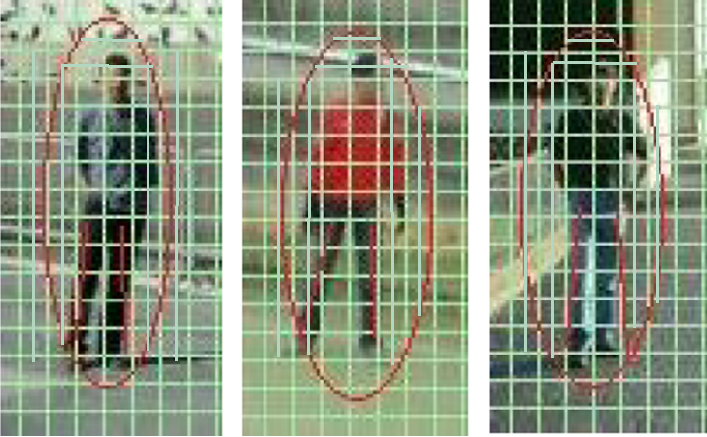
Non-uniform grid of points

Slide 38
References
N. Dalal and B. Triggs, “Histograms of oriented gradients for human detection,” in IEEE Conference on Computer Vision and Pattern Recognition, 2005.
Subhransu Maji et al. Classification using Intersection Kernel Support Vector Machines is Efficient. IEEE Computer Vision and Pattern Recognition 2008
C. Harris and M. Stephens. A combined corner and edge detector. In Alvey Vision Conference, pages 147–151, 1988.
D. G. Lowe. Distinctive image features from scale-invariant keypoints. International Journal of Computer Vision, 60(2):91–110, 2004.

